Slide 1
Dell PowerMax – (RAG) Chatbot
Dell Technologies Consulting - Singapore
Raghavendra Rathnamachary
Principal Consultant,
Dell Technologies Consulting, Singapore

Slide 2


Dell Consulting PowerMax (RAG) Chatbot

Slide 3
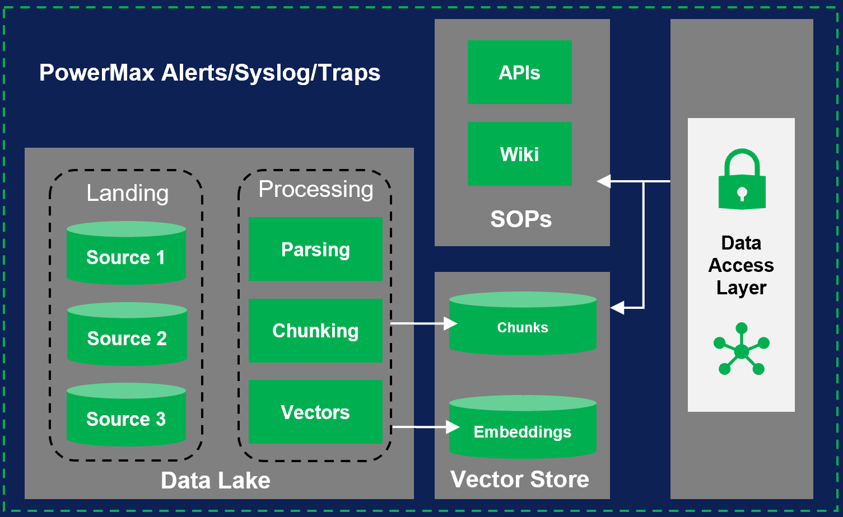
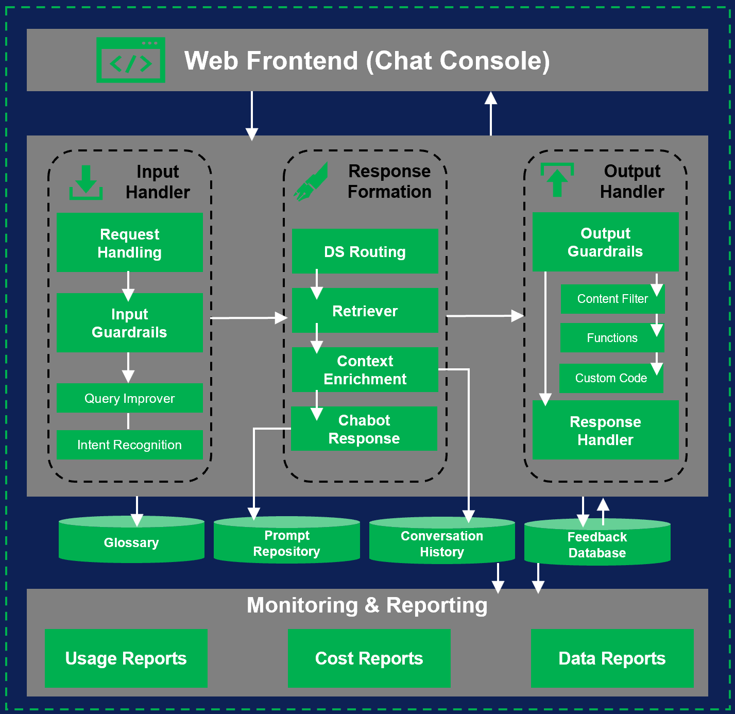
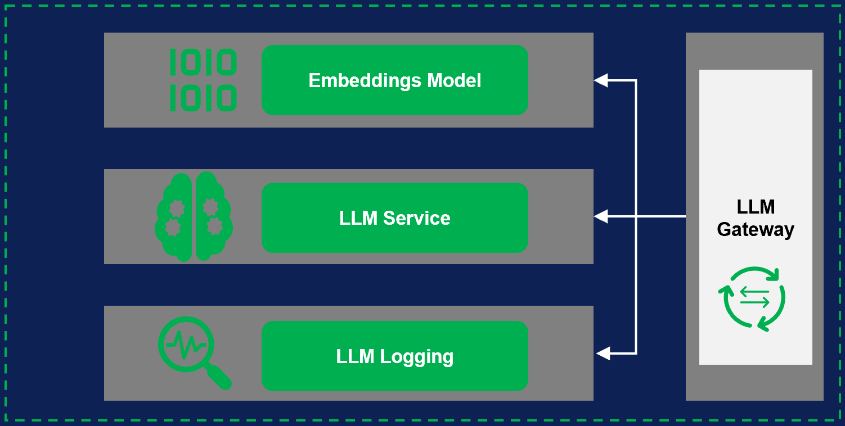
PowerMax – (RAG) Chatbot Architecture
LLMs

Slide 4
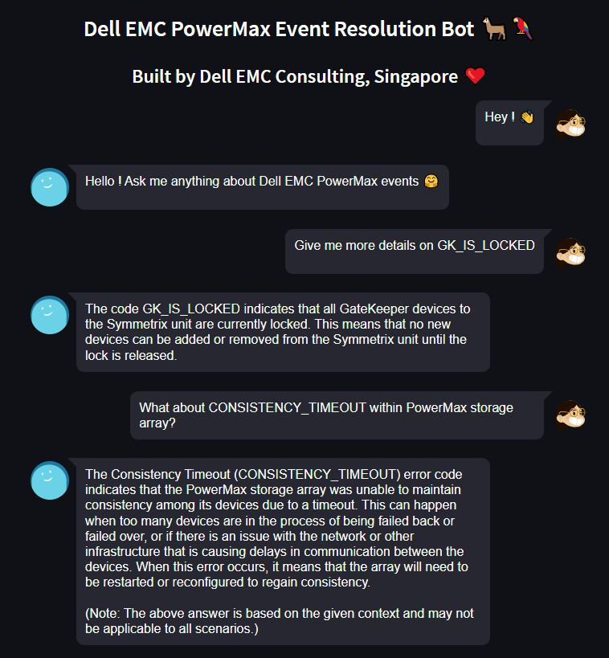

Demo of PowerMax Chatbot
Summary:
In this demo, we will launch a simple chatbot web application that will provide some of the resolution processes for PowerMax storage alerts.
It might also recommend applicable SOPs to be followed in the event of criticality for the Operations team

Slide 5
Thanks

Slide 6







Data Preparation
Inferences
Model Serving to embeddings model
(Transform text to Vector)
“I need a Python code to call
product API services”
4
3
1
2
Chatbot Model
Endpoint
0.1
0.2
1.1
0.8
0.3
1.20
…..
0.3
0.8
1.1
1.14
1.3
0.9
…..
0.2
0.5
1.2
1.4
0.6
1.9
…..
Engineer custom prompt with extended context
Raw Documents,
PDFs, SOPs, Runbooks
Doc Chunks
(Clean Dataset)
Knowing this context:
< Similar doc 1 from Vector Index >
< Similar doc 2 from Vector Index >
Answer the question:
How to grow strawberries?
Similarity Search
Parse/Split Documents
Split HTML/PDF documents and extract data
Vector Search Index
(Automatic Sync to your data)

